Slide 1


Cable, Bus Duct, and Bus Pipe Capacity Sizing Electric Power Load Analysis (EPLA) Revision of 6 May 2026
Dr. Norbert Doerry
http://doerry.org/norbert/MarineElectricalPowerSystems/index.htm
© 2026 by Norbert Doerry This work is licensed via: CC BY 4.0 (https://creativecommons.org/)

Slide 2
Essential Questions
What determines the required ampacity of cable, but duct, and bus pipe? | Understand
What are the factors that determine the ampacity of cables, bus duct, and bus pipe? | Understand
What are the impacts of non-fundamental frequency currents, installation details and ambient temperature on ampacity of cables, bus duct, and bus pipe? | Understand
How do bus pipe and bus duct installations differ from cable? | Understand
How can voltage drop calculations impact the size of cable, bus duct, and bus pipe? | Understand

Slide 3
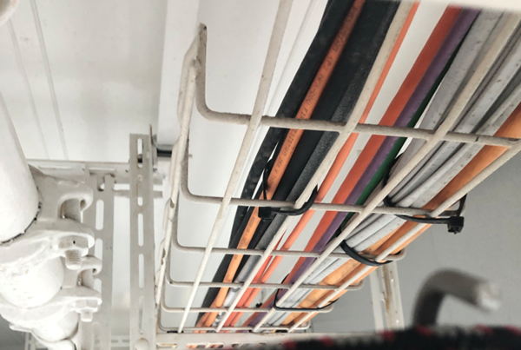
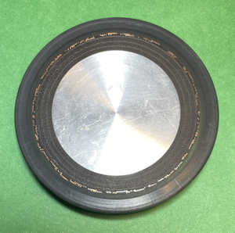
Introduction
Cables, bus duct, and bus pipe current rating (ampacity) is based on:
Limiting the temperature of the interface between the conductor and insulation to a value that enables insulation to achieve the stated design life.
Limiting the temperature of the outer surface to a value that is safe to touch.
Voltage drop calculations may also impact cable selection
Long cables may result in voltage at load interface being outside of power quality requirements.
Typically mitigated by using a larger (greater ampacity) cable with lower impedance.
Cables on Emerald Princess (Photo by Norbert Doerry)
Insulated bus pipe cross section (Photo by Norbert Doerry)

Slide 4
Load analysis – Required ampacity
Traditional load analysis
Assumes many loads where variation of the total load around the mean is small.
Usually applicable at the total ship level
Cables, bus duct, and bus pipe usually only serve a subset of the total load
The variation of the total load around the mean is relatively larger
Extended periods of time in an overload may result in insulation damage within the transformer
Zonal load factor method (DPC 310-1)
Zonal load factors account for variability in the total load due to having non- constant power loads
Almost always results in a larger operating load as compared to the traditional load analysis
Reduces risk of overloading cables, bus duct, and bus pipe.
Suse load flow or limiting load flow analysis to determine the worst case for bus-ties
Doerry, Norbert, "Shipboard power system limiting load flow and load flow analysis", IEEE ESTS 2025, Alexandria VA, August 5-8, 2025.

Slide 5
Margin and service life allowance
Margin accounts for uncertainty in the operating load estimate during design and construction
IEEE Std 45.1 recommendation
Detail Design Margin: 5% for existing follow-on designs to 20% for new first-time designs
Construction Margin: 5% for existing follow-on designs to 20% for new first-time designs
Service life allowance (SLA) accounts for growth in load while the ship is in-service
IEEE Std 45.1 recommendation
20% (1% per year for 20 years)

Slide 6
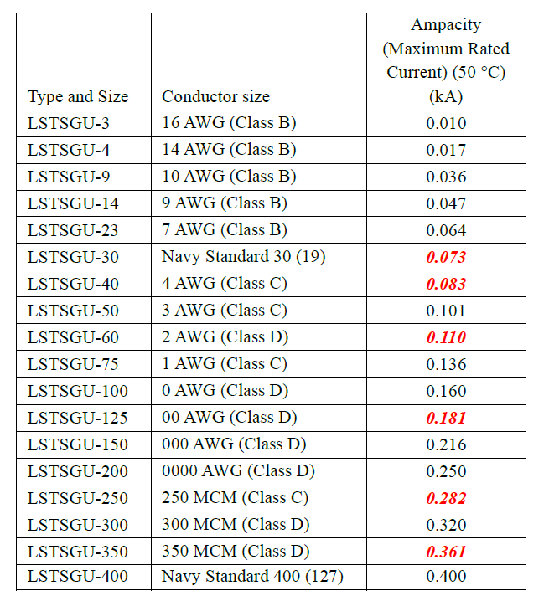
Rated Ampacity
LSTSGU Cable Ampacity
(bold-red-italic values are estimated)
Generally provided by manufacturer data sheets
Naval cable data provided in MIL-HDBK-299
Rated ampacity is based on
Ambient air temperature
Installation method (cable packing)
Presence of non-fundamental frequency current components

Slide 7
Harmonic and common mode currents
Harmonic and common mode currents create heat within the cable, bus duct, or bus pipe
Currents do not contribute to useful work
High Frequency current components concentrated on the outer edges of the conductor (skin effect) and experience a higher resistance that can increase heating,
Manufacturer datasheets should be consulted to determine impact of non-fundamental frequency currents on the published rated ampacity of the cable

Slide 8
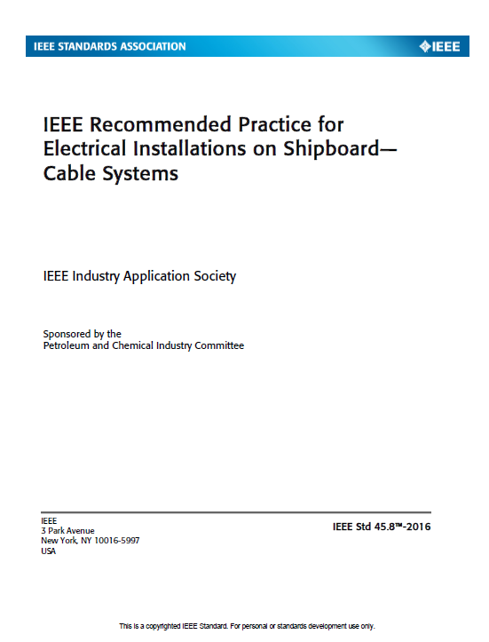
Ambient temperature adjustments
IEEE Std 45.8 provides tables for adjusting the ampacity of a cable based on ambient temperature

Slide 9
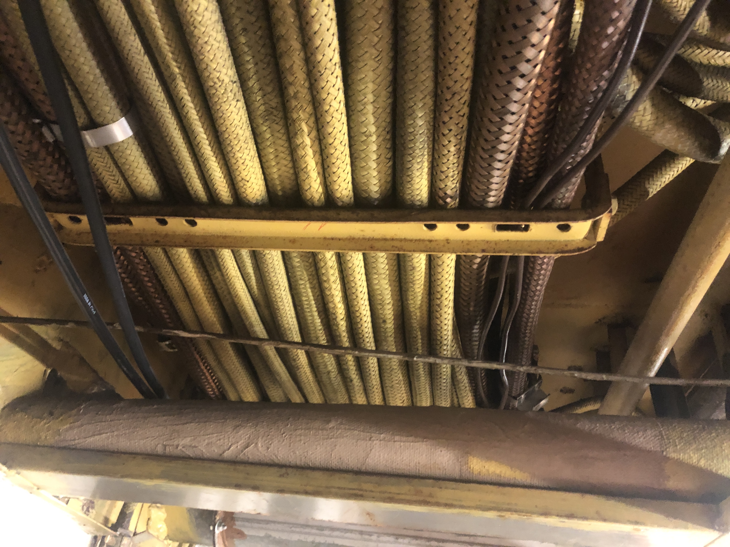
Installation method adjustments
Manufacturer’s datasheets should specify the assumed installation method for the rated ampacity.
IEEE Std. 45.8 describes process for adjusting the ampacity of a cable based on the installation method.
Suggests following relative multipliers to the rated ampacity:
1.0 Single banked, at least one cable diameter between adjacent cables
0.85 Single banked, less than one cable diameter between adjacent cables
0.68 Double banked, two layers of cables on the same cable tray
Cable on NS Savannah
Photo by Norbert Doerry

Slide 10
Voltage drop calculations
Long cables may employ a larger (higher ampacity) conductor size to help ensure the voltage at the load remains within voltage interface standards
Process for conducting voltage drop calculations described in:
Doerry, Norbert, "Voltage Drop Calculations on Shipboard Power Systems", presented at 16th International Symposium on Practical Design of Ships and Other Floating Structures PRADS 2025, Ann Arbor, MI, USA, October 19th - 23rd 2025.

Slide 11
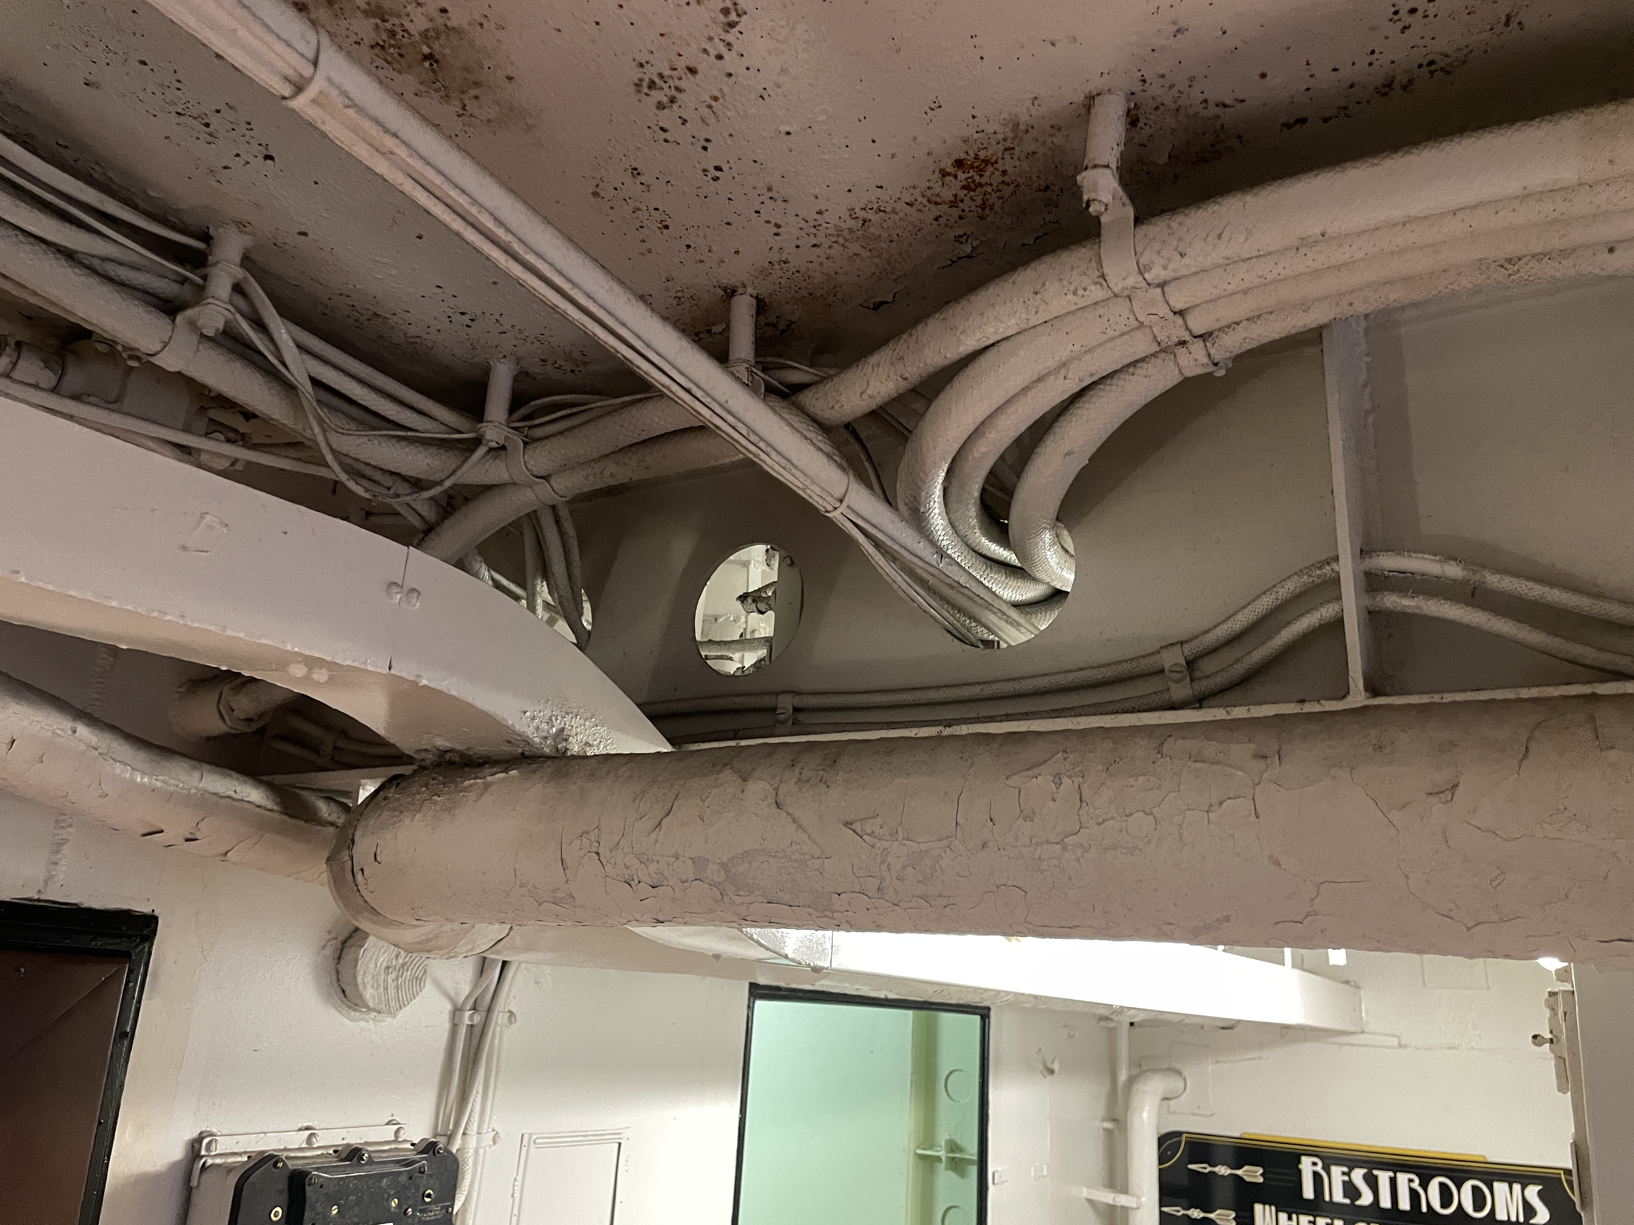
Bus Pipe and Bus Duct vs Cable
Maximum conductor size on cable usually limited by bend radius
Too large of a bend radius is impractical for shipboard arrangements.
Bend radius is typically on the order of 8 times the cable diameter
Most shipboard cables are less than 2.5 inches in diameter
Bus pipe and bus duct use special fittings that enable a very small bend radius
Enables much higher ampacity
May eliminate need to externally parallel cables
Insulated bus pipe cross section (Photo by Norbert Doerry)
Cable on USS Alabama (BB-60) (Photo by Norbert Doerry)

